Slide 1

Google App Store Data Clustering and Unsupervised Learning
By: Basil Latif

Slide 2
Project Goal:
The Goal: To see whether the number of app ratings versus the sum of app Reviews determines how many times an app gets installed.
Dependent variable: Installs
Independent variables: Ratings, Reviews

Slide 3
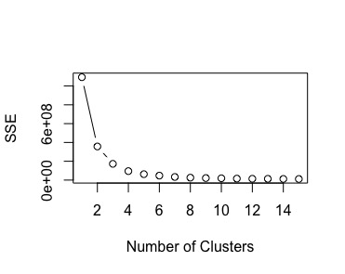
SSE Curve
Set k = 4

Slide 4
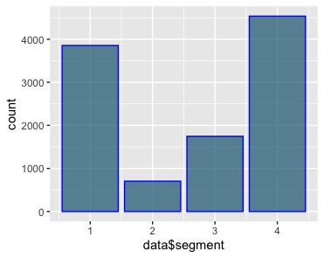
Count of Each Cluster Segment
Count Per Segment

Slide 5
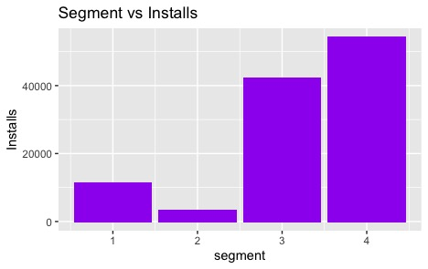
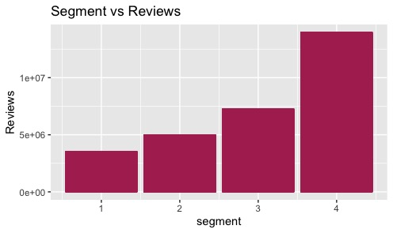
Installs & Reviews of Cluster Variable

Slide 6
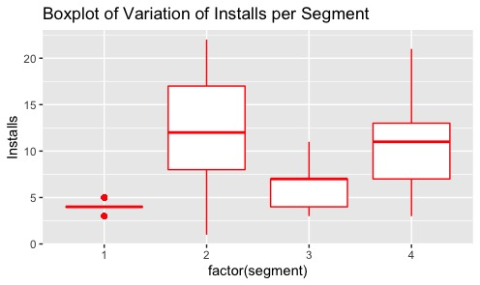
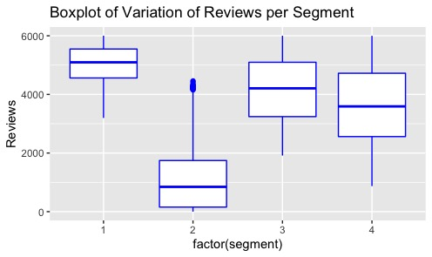
Boxplots of Cluster Variable

Slide 7
Regressions on Clusters

Slide 8
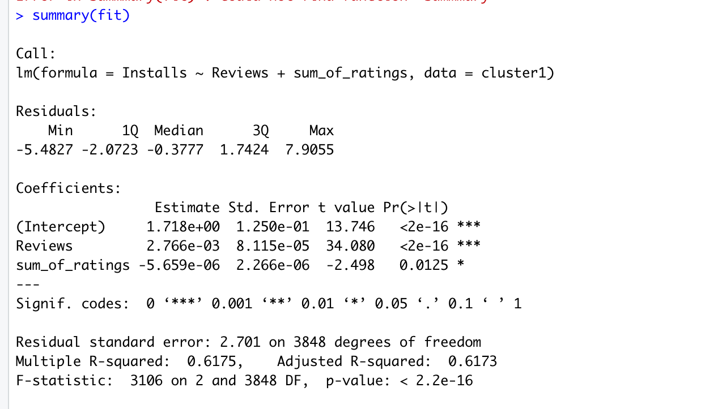
Cluster 1
Regression equation:
Y = 1.718 + 0.0027(Reviews) - 0.0000057(SumofRatings)

Slide 9
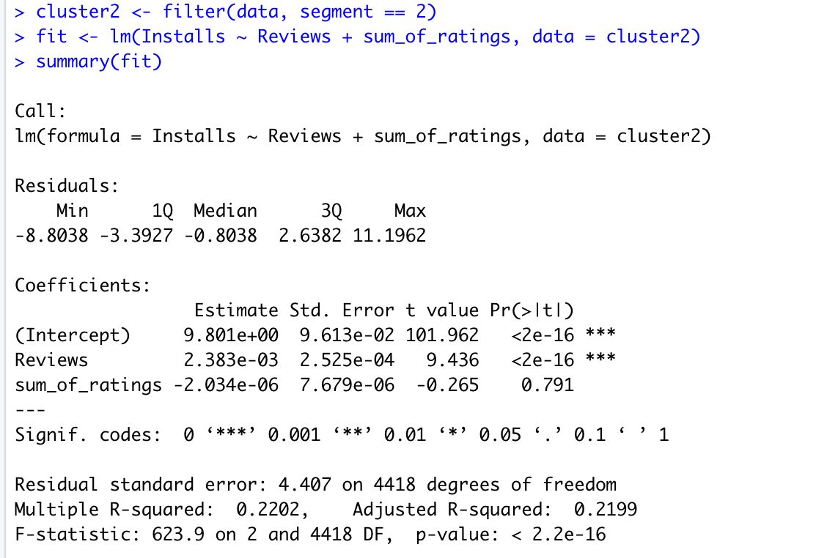
Cluster 2
Regression Equation:
Y = 9.80 + 0.0024(Reviews) – 0.000002(Sum_of_Ratings)

Slide 10
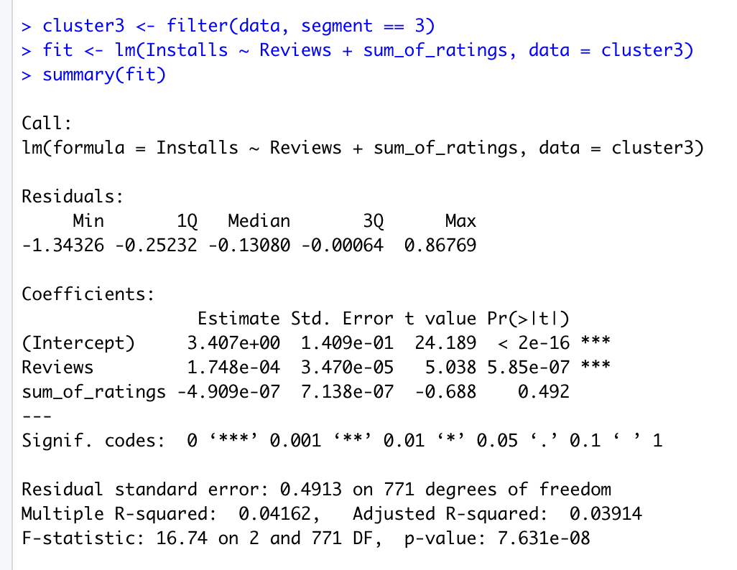
Cluster 3
Regression Equation:
Y = 3.4 + 0.00017(Reviews) – 0.00000049(Sum_of_ratings)

Slide 11
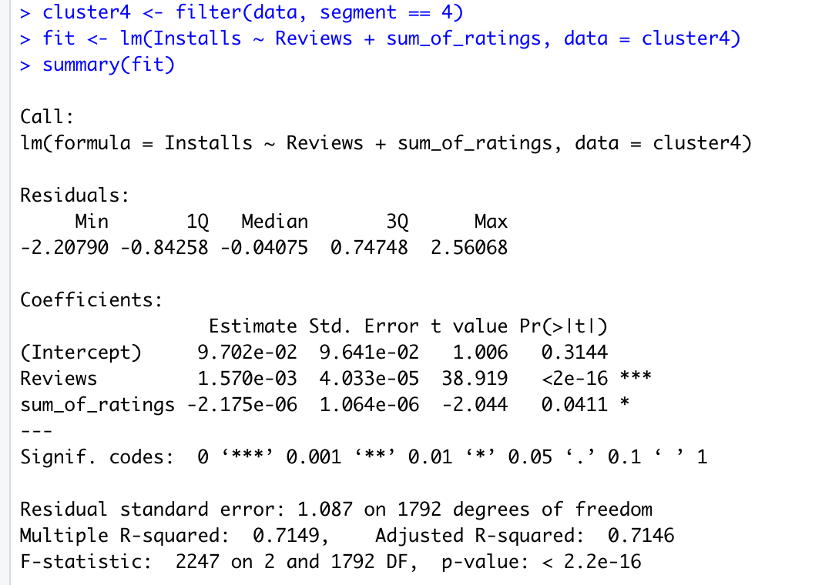
Cluster 4
Regression Equation:
Y = 0.097 + 0.0016(Reviews) – 0.0000022(Sum_of_ratings)

Slide 12
3 Insights
Insight #1: The number of reviews for an app will increase how many times it’s installed more than the number of ratings with a high degree of significance based on regression results. Every app review will increase the the number of installs.
Insight #2: In each of the clusters, the regression results show that the sum of ratings decreases the number of installs by a small amount with a high amount of statistical significance.
Insight #3: The rating of an app has a much smaller negative effect on install numbers than the positive effect of a review based on the regression results.

